Slide 1
AI VOICE ASSISTANT(JIA)
Presented by : Dipesh Patel
Exam No: 169
Shree P.M. Patel College of Computer Science & Technology, Anand

Slide 2
Index
SR. No. | Topics | Slide No.
1 | Project Definition | 3
2 | Project Profile | 4
3 | Need of System | 5
4 | Scope of proposed system | 6
5 | Features | 7
6 | System Overview | 10
7 | Algorithm Used | 11
8 | Use Case, Activity diagram, Class diagram, Sequence diagram | 12
9 | Data Dictionary | 17
10 | System Layout | 18
11 | Future Enhancement | 22
12 | Conclusion | 23
13 | Bibliography / Web Refrences | 24

Slide 3
Project Definition
Introduction
Virtual Assistants are software programs that help us ease our day to day tasks, such as showing weather report, creating reminders, providing knowledge on any topic etc.
They take’s commands via text (online chat bots) or by voice.
Voice based intelligent assistants need an invoking word or wake word to activate the listener, followed by the command.
For my project The wake word is JIA. We have so many virtual assistants, such as Apple’s Siri, Amazon’s Alexa and Microsoft’s Cortana.
This system is designed to be used efficiently on desktops.
Back to index

Slide 4
Project Profile
Project Title | AI Voice Assistant
Front End | Python (kivyMD)
BackEnd | MySQL
Operating System | MS Windows 11
Documentation Tool | Microsoft Office 2016
Hardware Requirement | Min 8GB RAM
Project Guide | Mr. Pradhyuman Parmar
Submitted By | Dipesh Patel
Submitted Through | Shree P.M. Patel College of Computer Science and Technology, Anand.
Submitted By | SARDAR PATEL UNIVERSITY V.V.Nagar.
Back to index

Slide 5
Need of The System
Performance :Voice assistants may have limitations in terms of their of their performance, such as the speed at which they can process and respond to user requests, or the complexity of tasks that they can handle.
Privacy and security :Voice assistants may not always clearly communicate their data collection and sharing practices to users, which could raise concerns about transparency and consent.
Customization :Voice assistants may not offer users a high degree of customization or control over their functionality, which could limit their usefulness and appeal to users.
Accuracy : Voice assistants may not always accurately understand or respond to user requests and queries, which can lead to frustration and a poor user experience.
Capabilities : Voice assistants may not support all tasks or functions that users may want to perform, and they may not be able to integrate with all devices or systems.
Back to index

Slide 6
SCOPE OF PROPOSED SYSTEM
Voice assistants will continue to offer more individualized experiences as they get better at differentiating between voices.
However, it’s not just developers that need to address the complexity of developing for voice as brands also need to understand the capabilities of each device and integration and if it makes sense for their specific brand.
They will also need to focus on maintaining a user experience that is consistent within the coming years as complexity becomes more of a concern.
This is because the visual interface with voice assistants is missing. Users simply cannot see or touch a voice interface.
Back to index

Slide 7
Features
It can get some real time information such as news headlines, weather report, IP address, Internet speed, and system stats.
It can also get entertaining contents such as jokes, latest movies or TV series, and playing songs and videos in YouTube.
It can perform system operations such as opening/closing/switching tabs, copying/pasting/deleting/selecting the text, creating a new file, taking screen shot, minimizing/maximizing/switching/closing windows.
Back to index

Slide 8
Merits
Convenience and Efficiency: AI voice assistants allow users to perform tasks hands-free, such as setting reminders, making calls, or sending messages, which can save time and streamline daily activities.
Accessibility: They help individuals with disabilities or those who have difficulty using traditional interfaces by providing an alternative means of interaction. Voice commands can assist those with visual impairments or motor difficulties.
Multitasking: Voice assistants enable users to multitask more effectively. For instance, you can cook while getting recipe instructions or exercise while listening to music or a podcast.
24/7 Availability: Unlike human assistants, AI voice assistants are available around the clock, providing support whenever needed without requiring breaks or downtime.
Information Retrieval: Voice assistants can quickly provide information on a wide range of topics, such as weather forecasts, news updates, or general knowledge, helping users stay informed without manual searching.
Entertainment: Voice assistants can play music, audiobooks, and podcasts, as well as provide interactive games and activities, offering a convenient source of entertainment.
Back to index

Slide 9
Module
Login / Register Panel: User Will need to register himself to use Application. After registration only user will be able to use Application.
User Panel: The Main GUI from which User will interact to Virtual Assistant. It Will be of two types as bellow.
ChatBot Panel: The GUI Page where User will be able to enter query and he/she will get response by Machine.
Talk Panel: The GUI Page Where User will be able to interact with Machine by Speaking Command and will get output by Machine through Speaker.
Back to index

Slide 10
System Overview
A virtual voice assistant is a software program that utilizes natural language
processing and voice recognition technologies to understand and
respond to spoken commands and queries.
Input (Voice)
Language Model
Output (Speaker)
User
Code (Process on input)
Recognize querys
Back to index

Slide 11
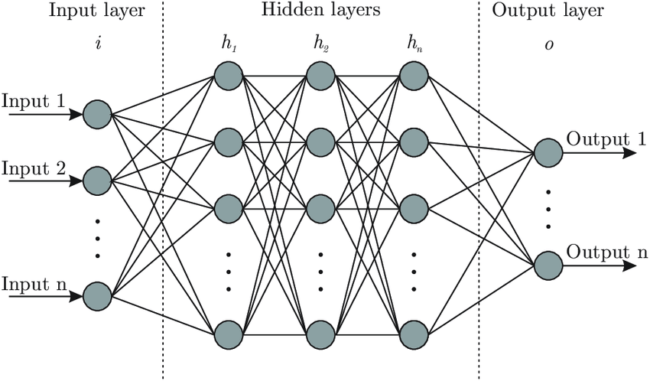
Algorithm used LLMs: Large language models (llms) are advanced AI systems designed to understand and generate human language. Here's a structured breakdown of their characteristics, functionality, applications, limitations, and ethical considerations.
Back to index

Slide 12
Use Case Diagram
Virtual Assistant
Commands
Queries
Interpreted to
Recieves
Response
Back to index

Slide 13
Class Diagram
User
+Command Audio/Text +Response Audio/Text
Listen() Speak()
Command trends to AI Brain
Brain
+Command String
Brain()
If String is Query
If String is Task
Question
+Command String
General() About() Search()
Task
+Command String
Reminder(),Research() Open Websites() Play Music()
Back to index

Slide 14
Activity Diagram
Command / Task
Wait for incoming query
If command
Check type
If question
If Quit
Execute Command
Good Bye
Execute Query
Back to index

Slide 15
Sequence Diagram for Query
User
Speaker
Listener
Interpreter
Web Scraper
1.Sends Query(Audio/Text)
2.Passes to
3.Query(Text)
4. Fetching Answer
5. Recieves
Answer(Audio/Text)
Back to index

Slide 16
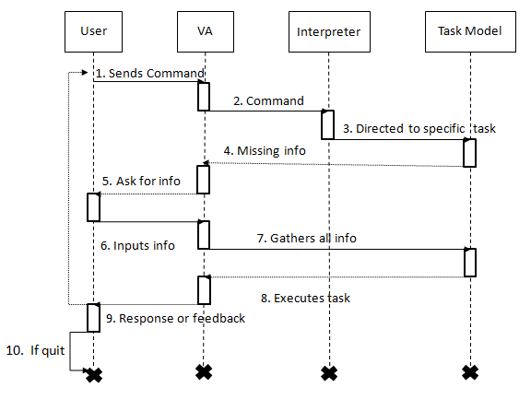
Sequence Diagram for Task

Slide 17
Data Dictionary
User Table: This table will be use to store user information to create username to personalize use of application.
Field Name | Data Type | Data Size | Constraint | Description
User Name | Varchar | 15 | Primary Key | Name of User.
Email Id | Varchar | 30 | Not Null | Email Id of User.
DOB | Date |  | Not Null | Date of birth
Password | Varchar | 12 | Not Null | Password given by user.
Back to index

Slide 18
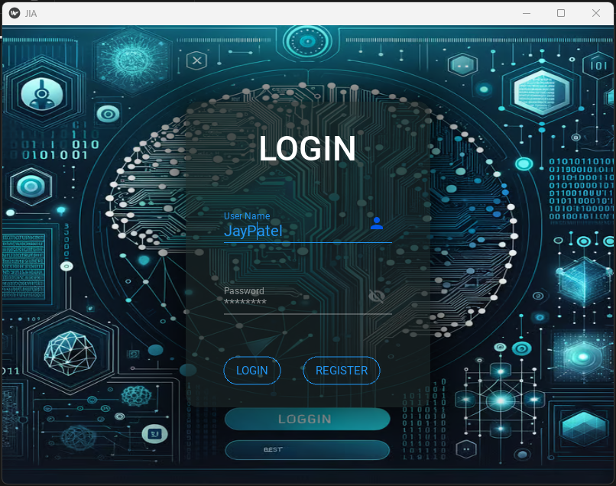
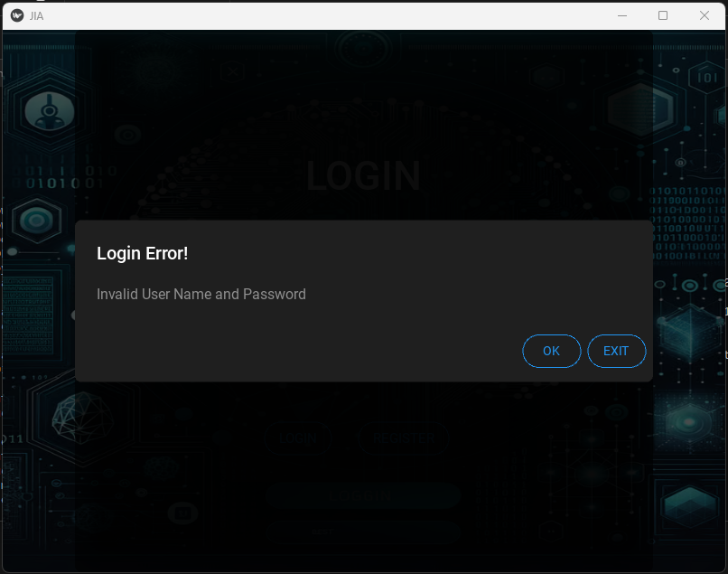
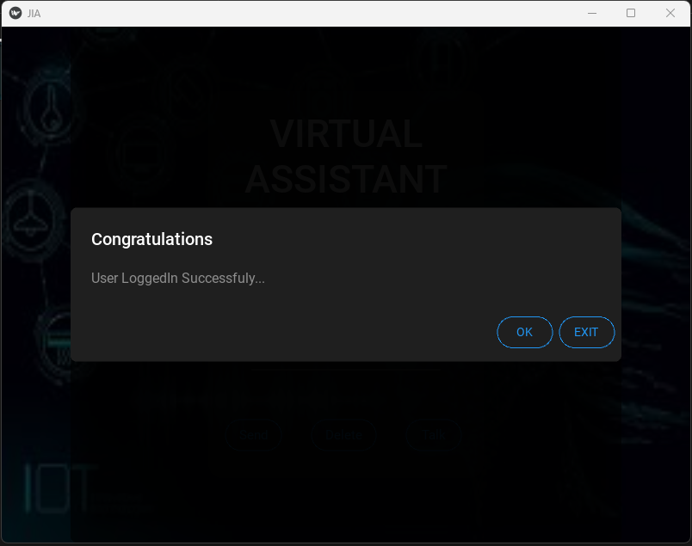
System layout
Login Page :This Form will be use to Login, if user is registered already.
Back to index

Slide 19
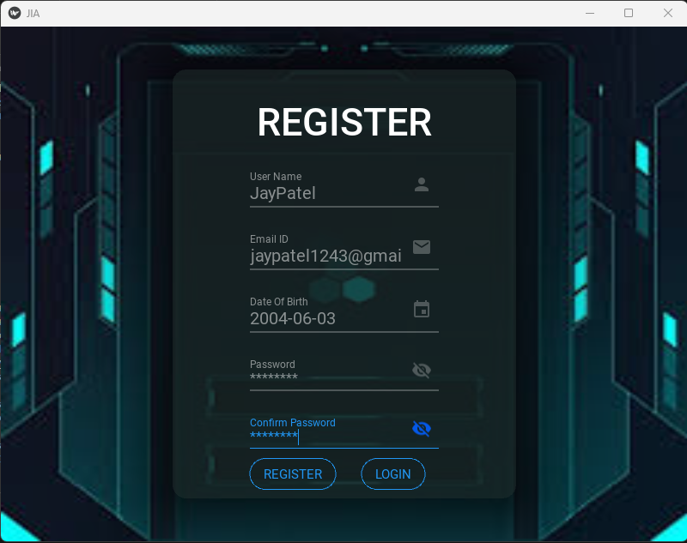
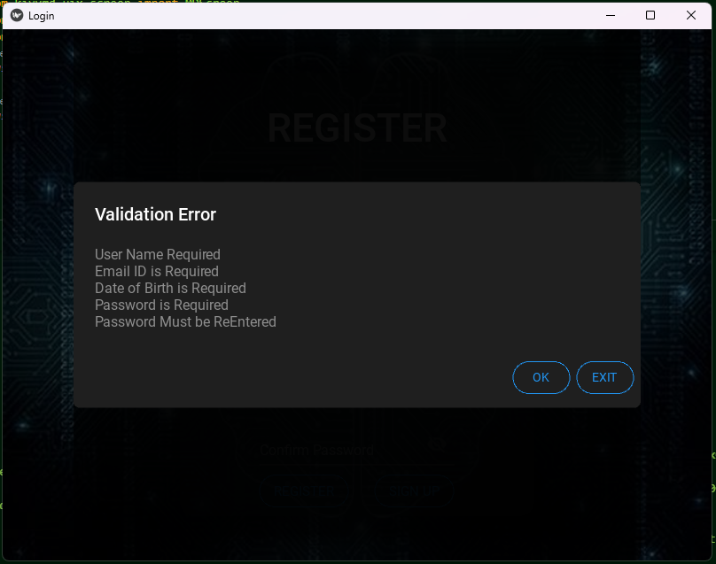
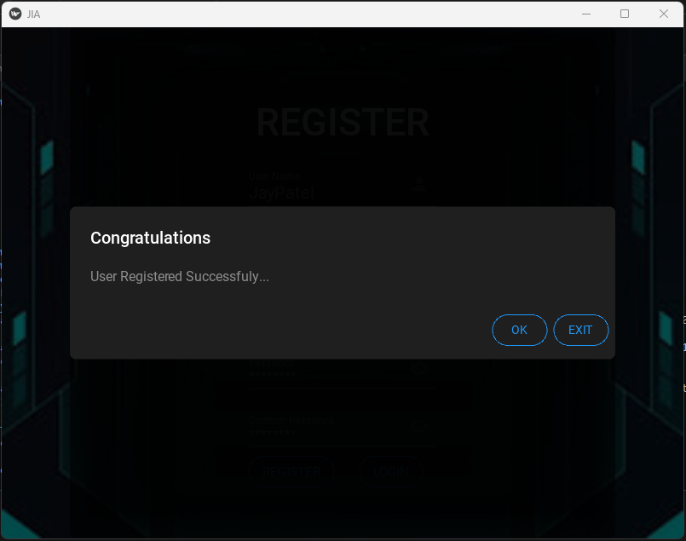
Registeration Page: This form will be use to Register or Create new user for Application.
Back to index

Slide 20
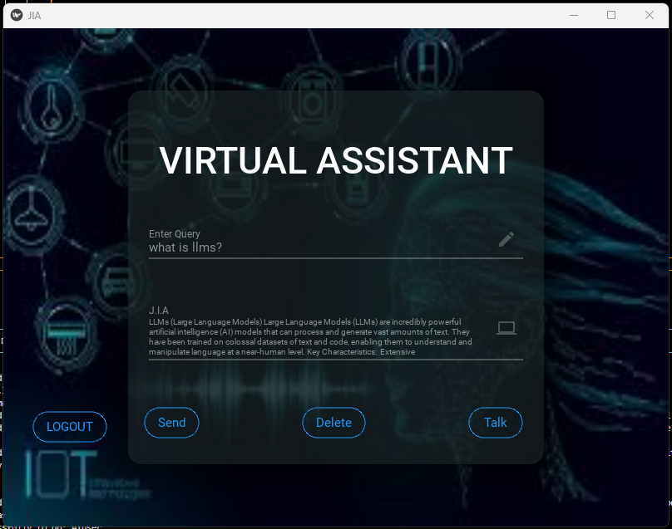
ChatBot Page: In this page user will be able to enter his or her query to JIA, and response will be generated through voice and written form.
Back to index

Slide 21
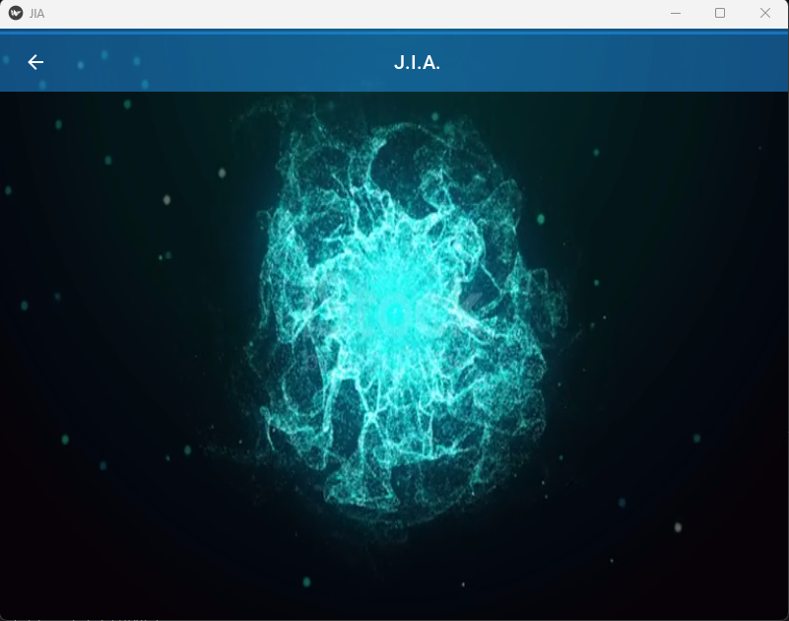

Talking Page: In this page user will establish conversation with virtual assistant directly by using microphone. Response will be generated through voice(speaker).
Back to index

Slide 22
Future Enhancement
In future, user will be able to select voice of AI Voice Assistant according to them.
User will be able to select language according to there convenience.
AI Voice Assistant will be able to work offline.
Implementing voice recognition for personalized responses and secure interaction.
Allowing user to add new command and skills, making it adaptable to specific needs.
Leverage AI to analyse user behaviour and usage patterns to provide more personalized and predictive suggestions over time.
Back to index

Slide 23
CONCLUSION
Through this voice assistant, we have automated various services using a single line command. It eases most of the tasks of the user like searching the web, retrieving weather forecast details. We aim to make this project a complete server assistant and make it smart enough to act as a replacement for a general server administration. The future plans include integrating JIA with mobile using React Native to provide a synchronised experience between the two connected devices.
Back to index

Slide 24
BIBLiOGRAPHY
https://www.w3schools.com
https://www.tutorialspoint.com
https://www.python.org/doc
Code with Harry Python Playlist
Back to index

